Slide 1
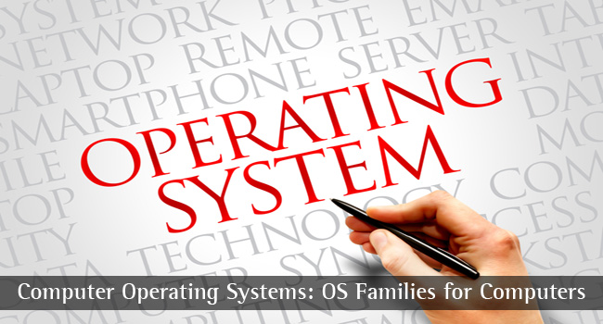

CS-3103 : Operating Systems : Sec-A (NB) :
Virtual Memory Management…..
CESN3103-Virtual Memory

Slide 2



In Virtual Memory systems, the unit of transfer of data from a program lying on the hard disk to the main memory is:
A page b) An overlay c) A word d) All of the above
Hint: What is overlay? overlaying means "the process of transferring a block of program code or other data into internal memory, replacing what is already stored“.
Ans: a)
A page fault is generated when the page is not found in the
Page Table b) Dirty Page frame list
c) Free page frame list d) None of the above
Hint: A dirty bit or modified bit is a bit that is associated with a block of computer memory and indicates whether or not the corresponding block of memory has been modified.The dirty bit is set when the processor writes to (modifies) this memory. The bit indicates that its associated block of memory has been modified and has not been saved to storage yet. When a block of memory is to be replaced, its corresponding dirty bit is checked to see if the block needs to be written back to secondary memory before being replaced or if it can simply be removed. Dirty bits are used by the CPU cache and in the page replacement algorithms of an OS.
Ans: a)
page replacement algorithms decide which memory pages to page out, sometimes called swap out, or write to disk, when a page of memory needs to be allocated. Page replacement happens when a requested page is not in memory (page fault).
CESN3103-Virtual Memory

Slide 3
CSEN3103: Virtual Memory
Background
Demand Paging
Performance of Demand Paging
Page Replacement
Page-Replacement Algorithms
Allocation of Frames
Thrashing
Demand Segmentation
CESN3103-Virtual Memory

Slide 4
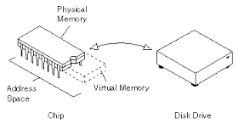
Virtual Memory
CESN3103-Virtual Memory

Slide 5
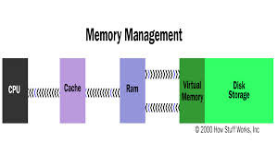
Virtual Memory
CESN3103-Virtual Memory

Slide 6
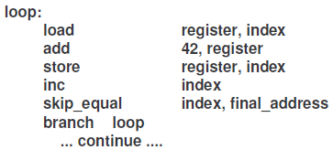
Virtual Memory
The instruction being executed must be in physical memory.
The instruction to be executed should be both necessary and reasonable.
Programs often have code to handle unusual error conditions. Since these errors seldom occur in practice, this code is almost never executed.
Arrays, lists, and tables are often allocated more memory than they actually need. An array may be declared arr[100], but, may be used for the first 10 elements. Rest remains unutilized.
CESN3103-Virtual Memory

Slide 7
Virtual Memory …..
The ability to execute a program that is only partially in memory has the following advantages:
A program would no longer be constrained by the amount of physical memory that is available. Users would be able to write programs for an extremely large virtual address space, simplifying the programming task.
Because each user program could take less physical memory, more programs could be run at the same time, with a corresponding increase in CPU utilization and throughput but with no increase in response time or turnaround time.
[Turnaround time is the interval between the submission of a
job and its completion.
Response time is the interval between submission of a request, and the first response to that request.]
CESN3103-Virtual Memory

Slide 8
Virtual Memory …..
Less I/O would be needed to load or swap user programs into memory, so each user program would run faster.
Thus, running a program that is not entirely in memory would benefit both the system & the user:
Virtual Memory (VM) involves the separation of logical memory as perceived by users from physical memory.
This separation allows an extremely large VM to be provided for programmers when only a smaller physical memory is available.
CESN3103-Virtual Memory

Slide 9
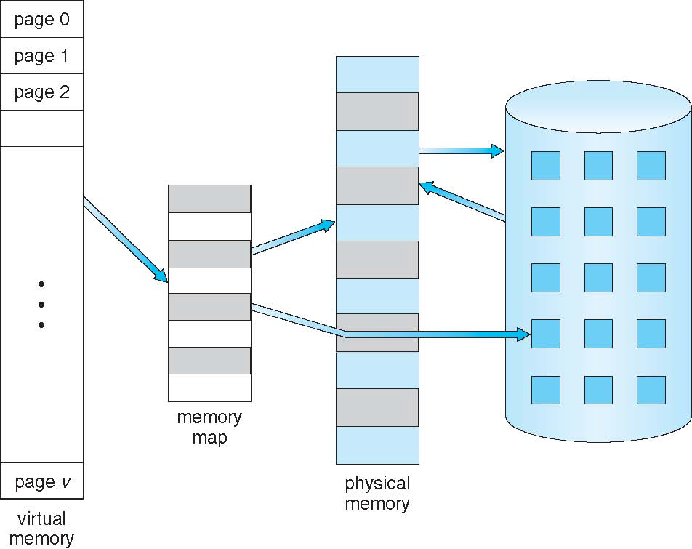
Virtual Memory That is Larger Than Physical Memory
CESN3103-Virtual Memory

Slide 10
Virtual Memory – key points to remember
Virtual memory – separation of user logical memory from physical memory.
  Only part of the program needs to be in memory for execution.
  Logical address space can therefore be much larger than physical address space.
  Need to allow pages to be swapped in and out.
Virtual memory can be implemented via:
  Demand paging
  Demand segmentation
CESN3103-Virtual Memory

Slide 11
Virtual Address Space
The virtual address space of a process refers to the logical (or virtual) view of how a process is stored in memory. In this view, a process begins at a certain logical address – say, address 0 – and exists in contiguous memory space.
The physical memory may be organized in page frames and that the physical page frames assigned to a process may not be contiguous.
It is up to the memory management unit (MMU) to map logical pages to physical page frames in memory.
We allow the heap to grow upward in memory as it is used for dynamic memory allocation.
Similarly, we allow for the stack to grow downward in memory through successive function calls.
CESN3103-Virtual Memory

Slide 12

Virtual Address Space
CESN3103-Virtual Memory

Slide 13
Demand Paging
Bring a page into memory only when it is needed.
  Less I/O needed
  Less memory needed
  Faster response
  More users
Page is needed ⇒ reference to it
  invalid reference ⇒ abort
  not-in-memory ⇒ bring to memory
CESN3103-Virtual Memory

Slide 14

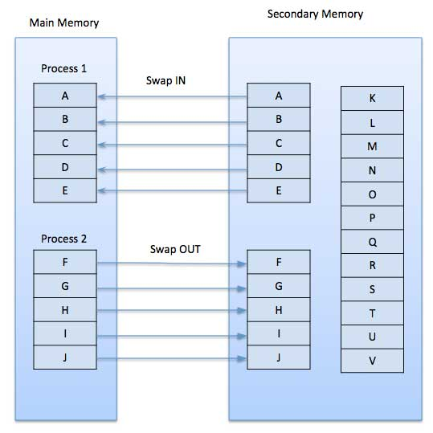
Demand Paging
CESN3103-Virtual Memory

Slide 15
Valid-Invalid Bit
With each page table entry a valid–invalid bit is associated
(1 ⇒ in-memory, 0 ⇒ not-in-memory)
Initially valid–invalid but is set to 0 on all entries.
Example of a page table snapshot.
During address translation, if valid–invalid bit in page table entry is 0 ⇒ page fault.
Frame #
valid-invalid bit
1
1
1
1
0
page table

0
0
CESN3103-Virtual Memory

Slide 16
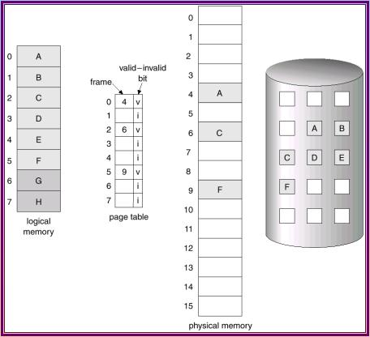
Page table when some pages are not in main memory
CESN3103-Virtual Memory

Slide 17
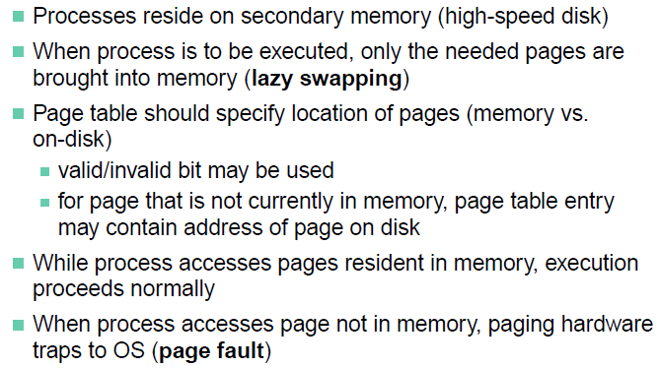
Demand Paging
CESN3103-Virtual Memory

Slide 18
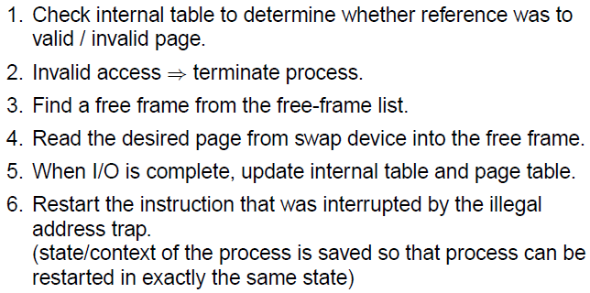
Page Fault
CESN3103-Virtual Memory

Slide 19
Page Fault
If there is ever a reference to a page, first reference will trap to
OS ⇒ page fault
OS looks at another table to decide:
  Invalid reference ⇒ abort.
  Just not in memory.
Get empty frame.
Swap page into frame.
Reset tables, validation bit = 1.
Restart instruction: Least Recently Used
  block move
  auto increment/decrement location
Fetch and decode the Instruction (ADD)
Fetch A
Fetch B
Add A and B
Store the sum in C
If we fault when we try to store in C (because C is in a page not currently in memory), we will have to get the desired page, bring it in, correct the page table, and restart the instruction.
CESN3103-Virtual Memory

Slide 20
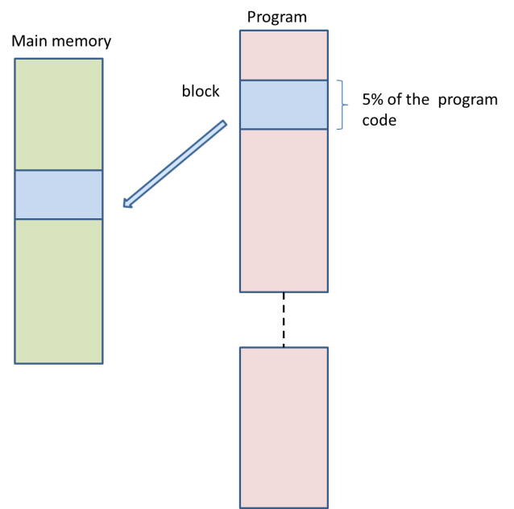
Virtual Memory
CESN3103-Virtual Memory

Slide 21
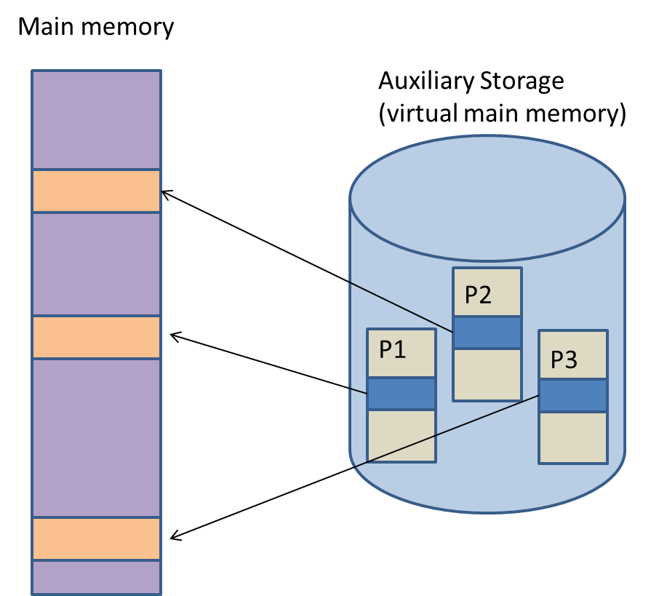
Virtual Memory
Main memory and auxiliary storage have been logically combined by the OS to give the illusion that a main memory of extremely large size is available with the system.
CESN3103-Virtual Memory
Active portions of processes P1, P2 and P3 loaded into main memory

Slide 22

Operating System Concepts

Slide 23
What happens if there is no free frame?
Page replacement – find some page in memory, but not really in use, swap it out.
  algorithm
  performance – want an algorithm which will result in minimum number of page faults.
Same page may be brought into memory several times.
CESN3103-Virtual Memory

Slide 24
Page Replacement
Prevent over-allocation of memory by modifying page-fault service routine to include page replacement.
Use modify (dirty) bit to reduce overhead of page transfers – only modified pages are written to disk.
Page replacement completes separation between logical memory and physical memory – large virtual memory can be provided on a smaller physical memory.
CESN3103-Virtual Memory

Slide 25
Active Page Replacement Policies
FIFO: Utilizing queue data structure, replaces the first VM page that got accepted/included in MM for program execution.
Optimal Page Replacement Policy: According to Belady (1966), at a page fault, replace the page whose next reference is farthest in the page reference string. This policy’s drawback in practical scenario :- Infeasible because VM handler does not have knowledge of the future behavior of a process.
CESN3103-Virtual Memory

Slide 26
Active Page Replacement Policies
LRU Page Replacement: Uses the principle of locality of reference (once a page is referred, it may be referred in near future). At every page fault, the least recently used page is replaced by a new page.
The page table entry (PT) of a page records the time when the page was last referenced. This piece of information is initialized when the VM page is loaded in VM system and is modified every time the same page is referenced.
CESN3103-Virtual Memory

Slide 27


Let’s learn VM with assignments….
Problems on Demand Paging, Page replacement Algorithms (FCFS, LRU), Allocation of frames, thrashing……
CESN3103-Virtual Memory

Slide 28
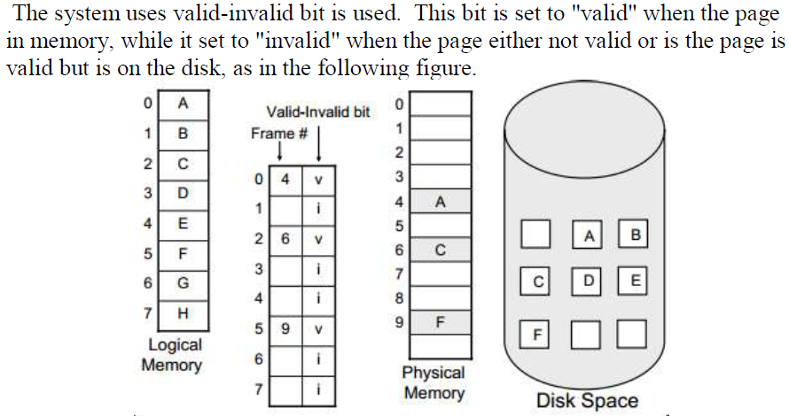
CESN3103-Virtual Memory

Slide 29
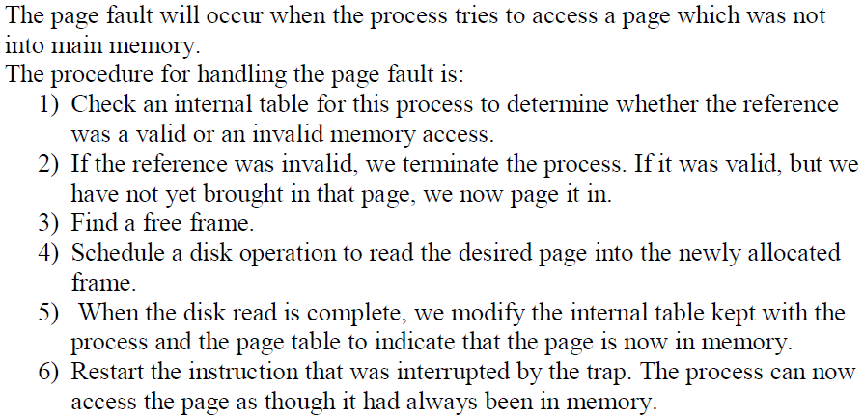
CESN3103-Virtual Memory

Slide 30
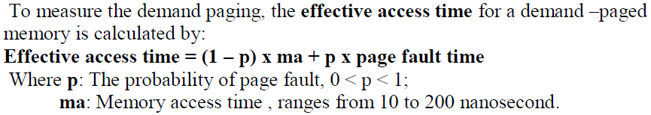
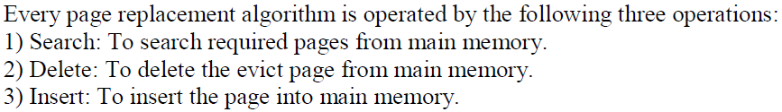
Delete: Swap – out equivalent to evict. Insert : Swap - in
CESN3103-Virtual Memory

Slide 31

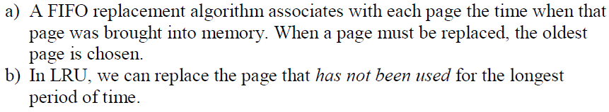
CESN3103-Virtual Memory

Slide 32
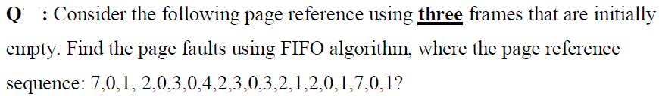
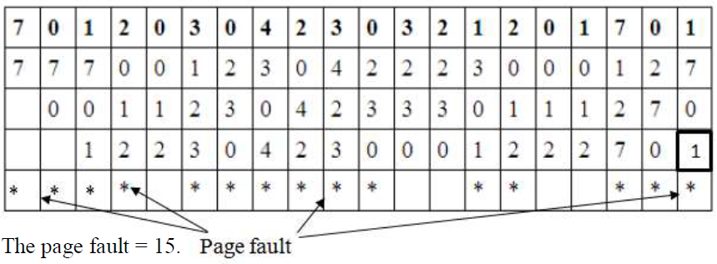
3 frames vs 20 pages
CESN3103-Virtual Memory

Slide 33

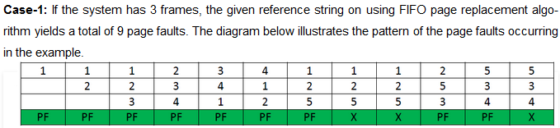
Belady’s Anomaly
Bélády’s anomaly is the name given to the phenomenon where increasing the number of page frames results in an increase in the number of page faults for a given memory access pattern.
CESN3103-Virtual Memory

Slide 34
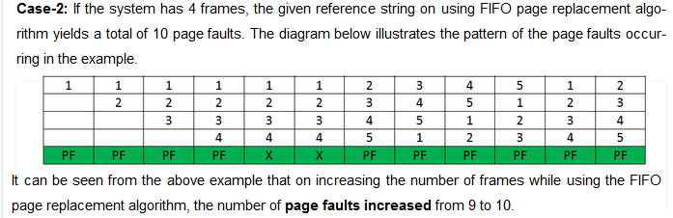
Belady’s Anomaly
CESN3103-Virtual Memory

Slide 35
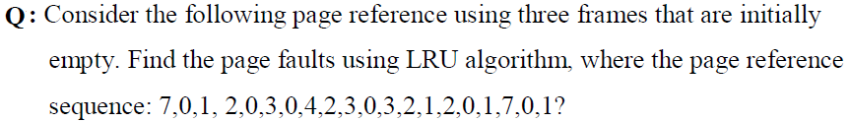
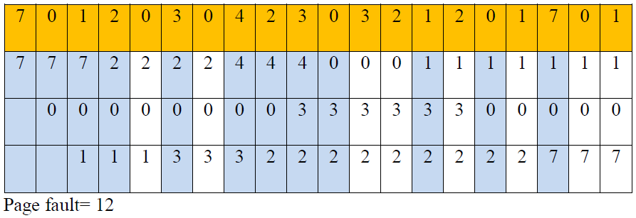

CESN3103-Virtual Memory

Slide 36

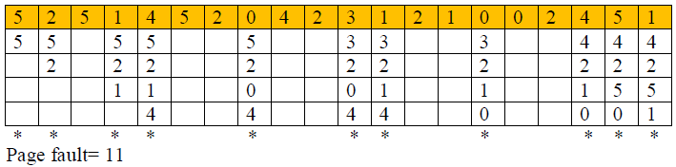

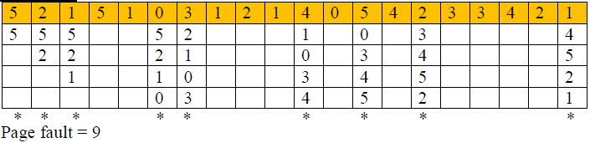
CESN3103-Virtual Memory

Slide 37
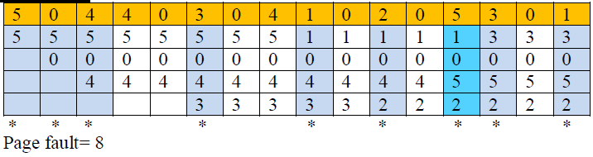
CESN3103-Virtual Memory

Slide 38
Desirable Page Fault Characteristics
Page
Fault
Rate
Desirable operating Zone
Low page fault zone
High page fault zone
No. of page frames allocated to a process →
CESN3103-Virtual Memory

Slide 39
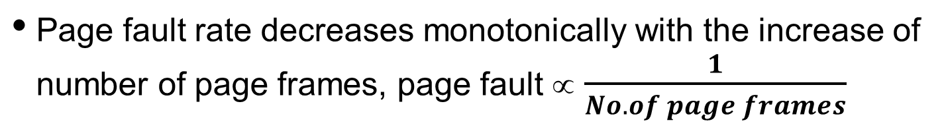
Page Fault & Thrashing
Let’s consider a process (Pi) operating to the left of the desirable operating zone, i.e., in the region of high page fault rates. If all processes in the system operate in high page fault rate zones, the CPU would be mostly busy performing page traffic & process switching, resulting in poor average response time or throughput → resulting in thrashing.
CESN3103-Virtual Memory

Slide 40
Thrashing
If a process does not have “enough” pages, the page-fault rate is very high. This leads to:
  low CPU utilization.
  operating system thinks that it needs to increase the degree of multiprogramming.
  another process added to the system.
Thrashing ≡ a process is busy swapping pages in and out.
Definition: situation in which a process is spending more time paging than executing
CESN3103-Virtual Memory

Slide 41
A process that is spending more time paging than executing is said to be thrashing. In other words it means, that the process doesn't have enough frames to hold all the pages for its execution, so it is swapping pages in and out very frequently to keep executing. Sometimes, the pages which will be required in the near future have to be swapped out.
Page Fault Frequency: another approach to preventing thrashing.
Per-process replacement; at any given time, each process is allocated a fixed number of physical page frames.
Monitor the rate at which page faults are occurring for each process.
If the rate gets too high for a process, assume that its memory is overcommitted; increase the size of its memory pool.
If the rate gets too low for a process, assume that its memory pool can be reduced in size.
If the sum of all memory pools don't fit in memory, deactivate some processes.
CESN3103-Virtual Memory

Slide 42
In demand paging, pages are brought into the physical memory only when the pages are needed. All the pages of a process need not be kept in the main memory at the same time. Only the pages that are used currently need to be kept in the main memory. Suppose a page is brought into the main memory and if there is no free frame in the main memory, a victim page is chosen from the main memory, the victim page is moved out to the backing store and the required page is brought into the main memory. Choosing a victim page for replacement is done by the page replacement algorithms.
The other option is to maintain a pool of free frames always and move in the required page into a frame. The victim page can be moved out later and that frame can be added to the pool of free frames.
Fragmentation: The most severe problem caused by fragmentation is causing a process or system to fail, due to premature resource exhaustion: if a contiguous block must be stored and cannot be stored, failure occurs. Fragmentation causes this to occur even if there is enough of the resource, but not a contiguous amount.
CESN3103-Virtual Memory

Slide 43
Solution to external fragmentation :
1) Compaction : shuffling the fragmented memory into one contiguous location.
2) Virtual memory addressing by using paging and segmentation. External fragmentation can be reduced by compaction or shuffle memory contents to place all free memory together in one large block.
CESN3103-Virtual Memory

Slide 44

Thrashing Diagram
Why does paging work?
Locality model
  Process migrates from one locality to another.
  Localities may overlap.
Why does thrashing occur?
Σ size of locality > total memory size
CESN3103-Virtual Memory

Slide 45
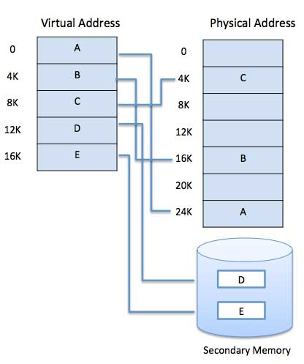
Demand Segmentation
Operating system also uses demand segmentation, which is similar to demand paging.
Operating system to uses demand segmentation where there is insufficient hardware available to implement 'Demand Paging'. The segment table has a valid bit to specify if the segment is already in physical memory or not.
CESN3103-Virtual Memory

Slide 46
Demand Segmentation
Operating system also uses demand segmentation, which is similar to demand paging. Operating system to uses demand segmentation where there is insufficient hardware available to implement ‘Demand Paging’.
The segment table has a valid bit to specify if the segment is already in physical memory or not. If a segment is not in physical memory then segment fault results, which traps to the operating system and brings the needed segment into physical memory, much like a page fault.
Demand segmentation allows for pages that are often referenced with each other to be brought into memory together, this decreases the number of page faults.
Another space server would be to keep some of a segment’s page tables on disk and swap them into memory when needed.
CESN3103-Virtual Memory

